Slide 1
Online Billing System for Cafeteria products using Resource Oriented architecture approach
Final Report
Krishna Kumar G
BITS ID: 2013HT78070
Cognizant ID: 355228

Slide 2
Objective
The basic objective of this work is to have a system that can ease the employees of Cognizant Chennai for their cafeteria billing process in an efficient and easy way.
Currently the employees stand in long queue to get billed and pay for their food items losing productivity
This system will assist the employees by presenting different ways to choose and order food items from their mobile devices.

Slide 3
Scope
The Scope of dissertation is to create a full online system to buy food items in various food outlets in cafeteria of cognizant Chennai offices by employees with their mobile handset
A web based application for vendors and admin to maintain the system.
A Kiosk application-desktop java application to view and print bill details.
The Solution has been designed to use light weighted RestFul Web services for data interchange among its components and also cost effective by employing Open source framework and tools.

Slide 4
Advantages of the system
Automated and Cost effective solution.
Easy implementation in Cognizant premises.
Reduces unwanted usage of cafeteria billing space.
Highly flexible system architecture with easy plugin options for new components into the system.
Increases productivity and reduces stress among employees
Increase customer satisfaction for vendors.
Easy maintenance for vendors and admin.
Optimized mobile data usage by communicating through Restful based web services

Slide 5
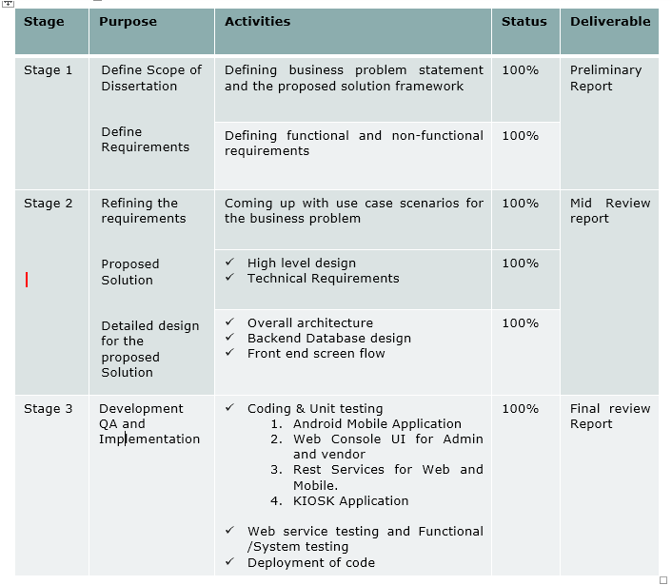
Project Plan

Slide 6
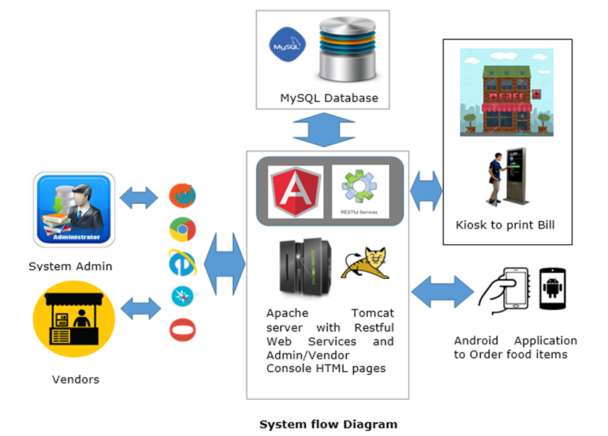

Slide 7
Solution Architecture
Presentation Layer:
• Web Application for admin and vendor can be viewed through HTML compatible browsers.
• Mobile Application for Employees or End users that can be installed in Android mobile devices.
• Kiosk Application can be installed and used in desktops with JDK1.6/JRE 1.6
Business Logic Layer:
Business Logic layer will be implemented using JAX RS framework as Restful web services.
Data Access Layer:
Data access layer will be implemented using Hibernate framework, which is a open source java persistence framework.
Restful web services and Web Application will be hosted as same application for demo purpose.

Slide 8
Solution Architecture (Cont’d..)
Admin and Vendor Console:
Used by the admin and vendor to manipulate data such as items , categories ,vendors , location in the database
Mobile Application – My Cafeteria :
Used by the End Users or employees to search food items and order the same, adding items as favorites, viewing the order details.
Kiosk application:
Used by the end users or employees at the cafeteria location to generate the bill. By entering the secret code present in the order ,the user can view and print the bill for the food items.
Restful Web Services:
All the above components communicate with the database through this Web service component . The communication protocol used is JSON format.

Slide 9
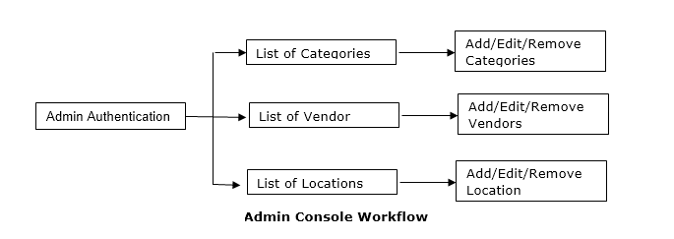
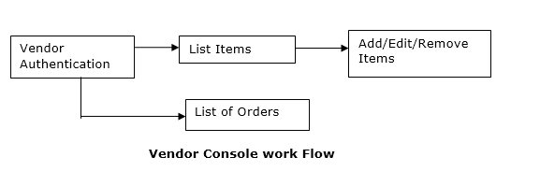
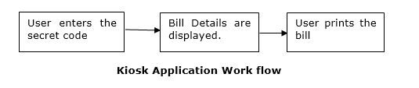
Flow Diagram

Slide 10
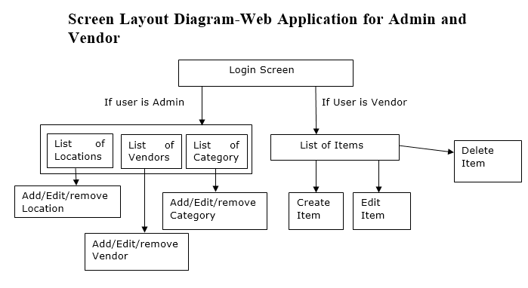

Slide 11
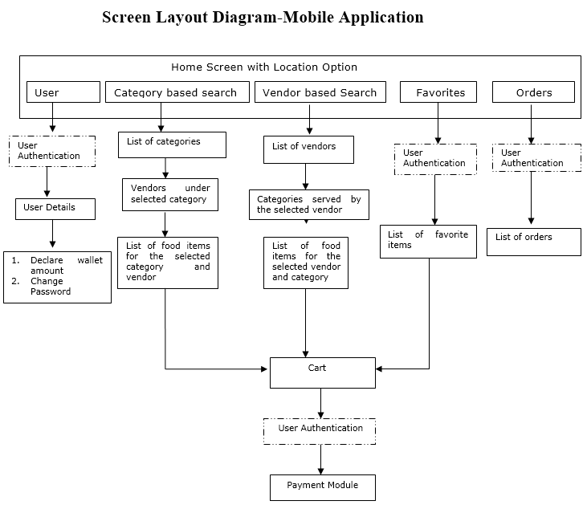

Slide 12
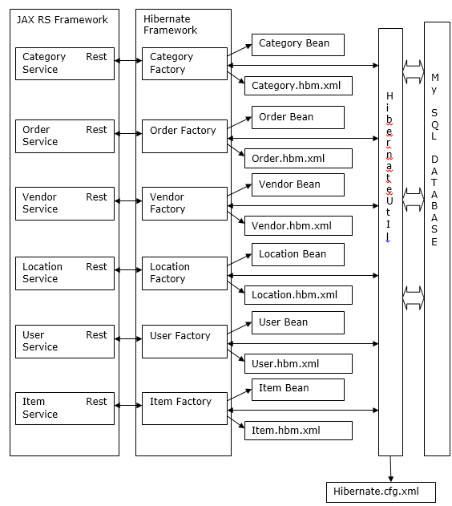
Class diagram architecture for Rest services

Slide 13
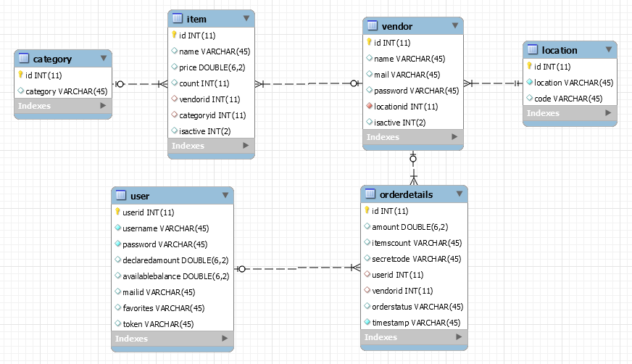
E-R Diagram for Backend

Slide 14
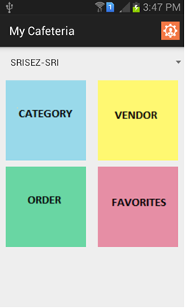
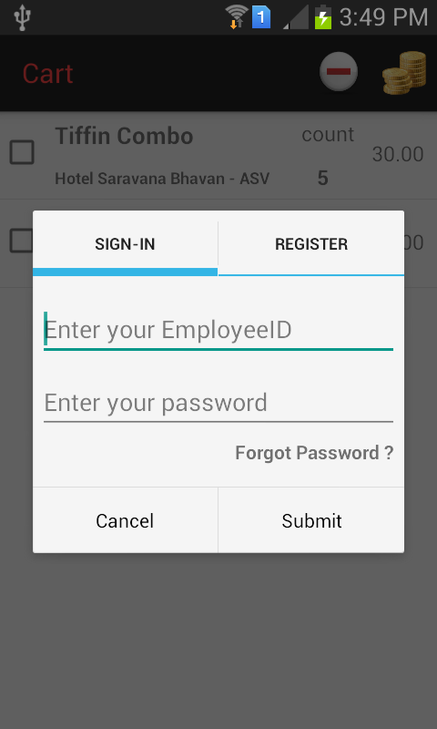
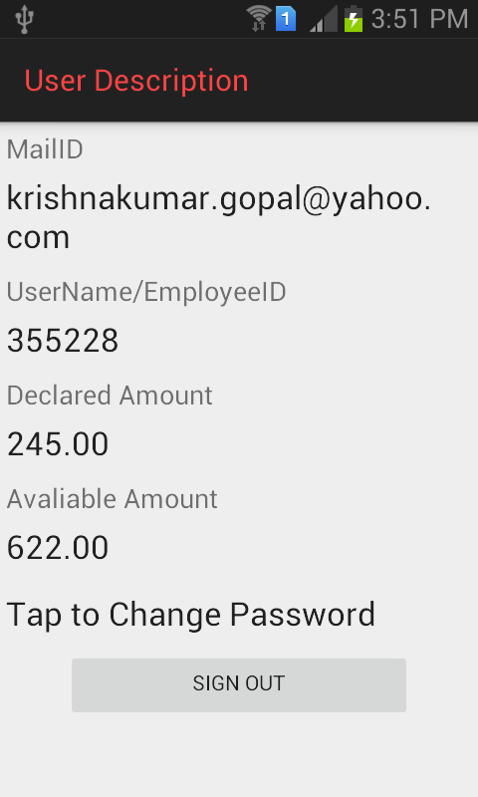
Screenshots for Mobile Application

Slide 15
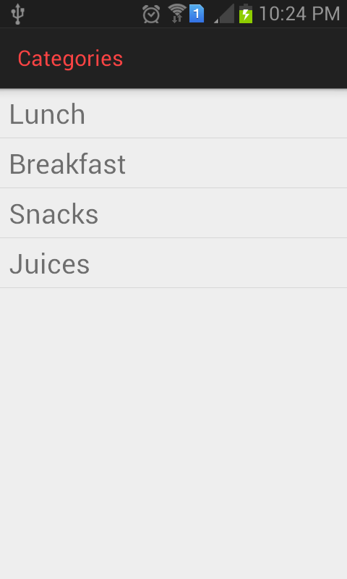
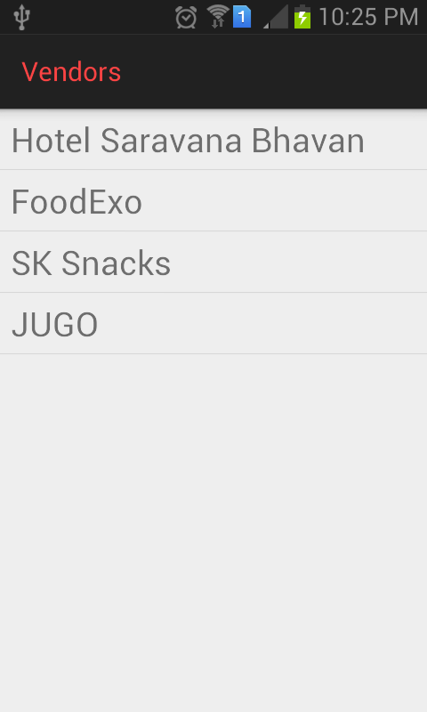
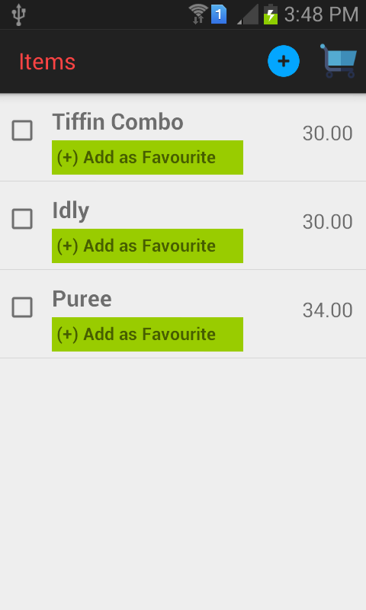
Screenshots for Mobile Application[Cont.]

Slide 16
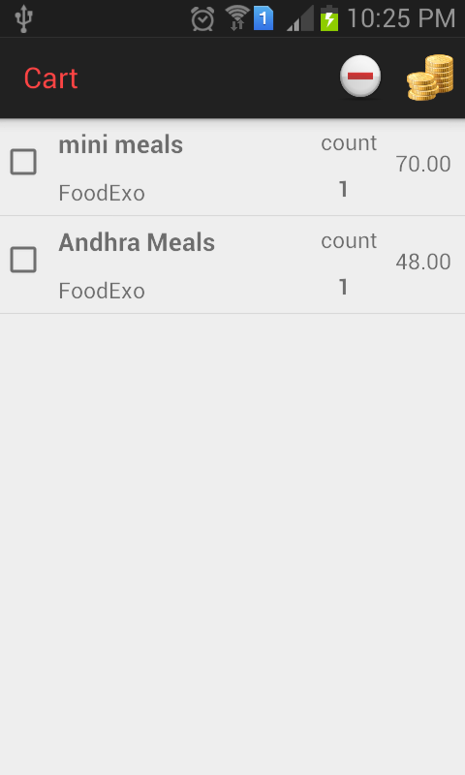
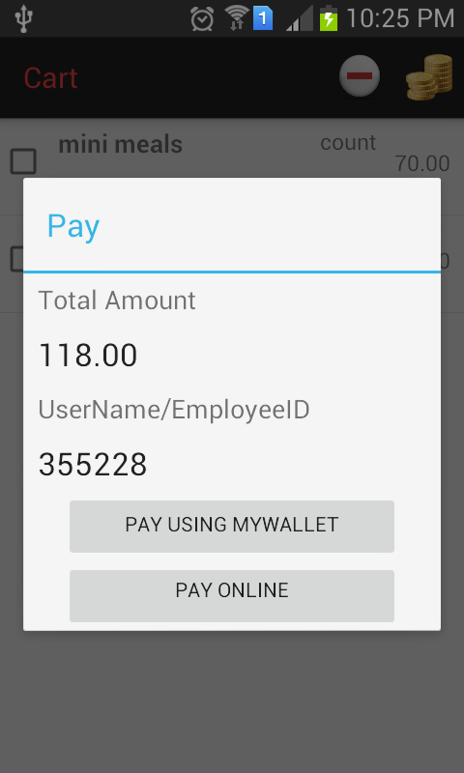
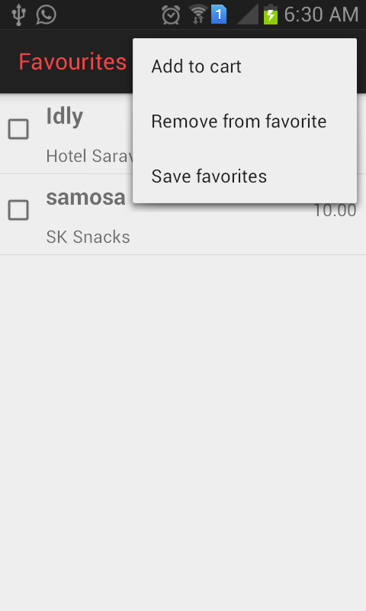
Screenshots for Mobile Application[Cont.]

Slide 17
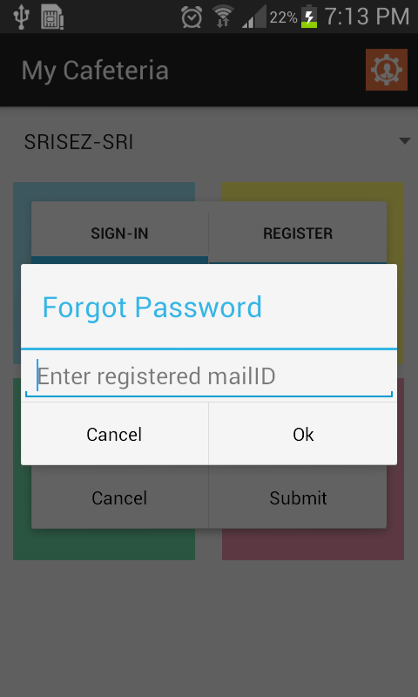
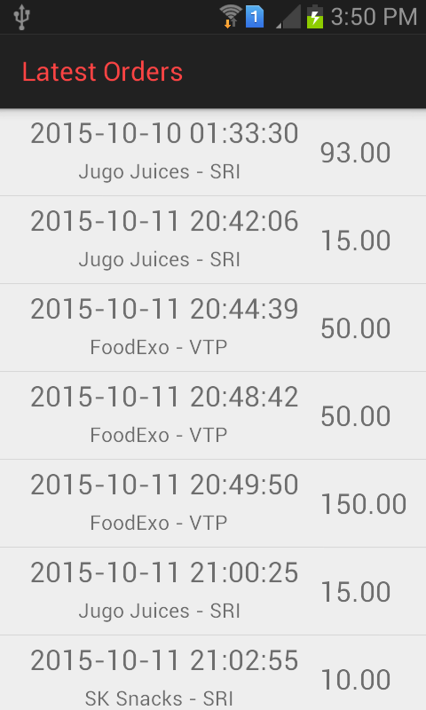
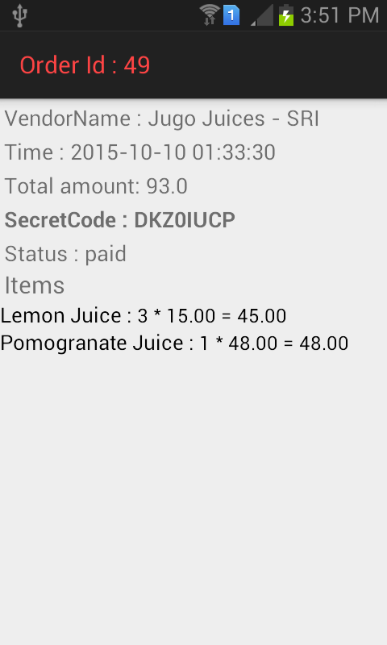
Screenshots for Mobile Application[Cont.]

Slide 18
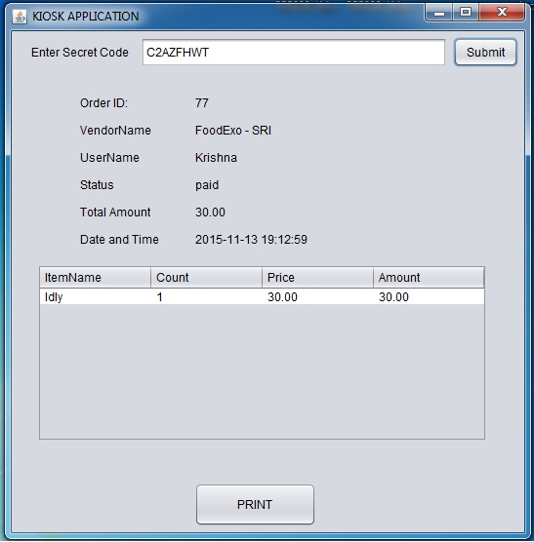
Screenshots for Kiosk Application

Slide 19
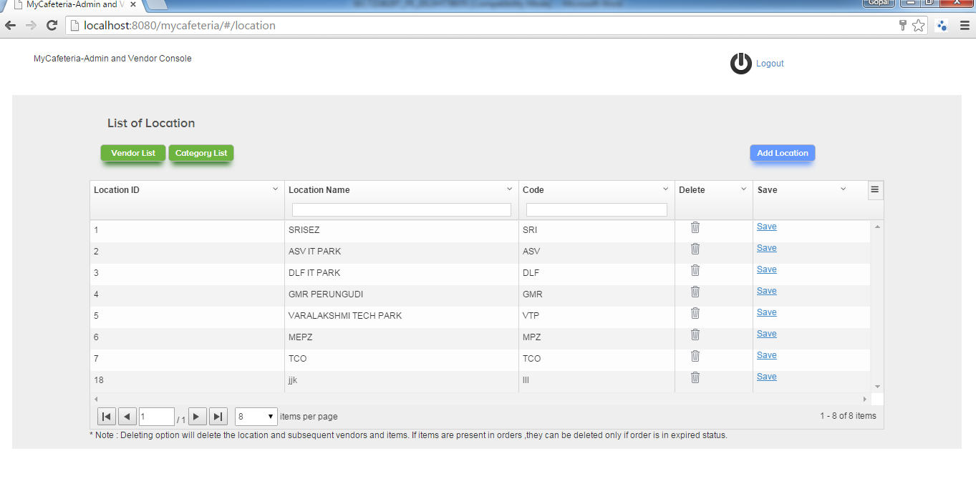
Mock Screenshots for Admin Console-Locations

Slide 20
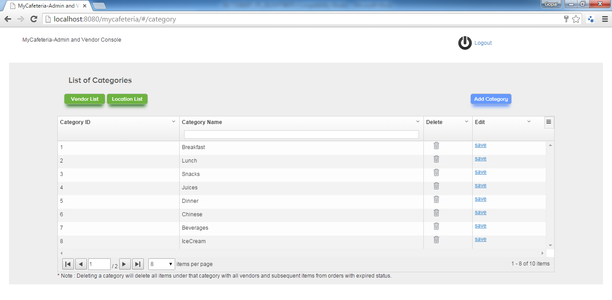
Screenshots for Admin Console-Categories

Slide 21
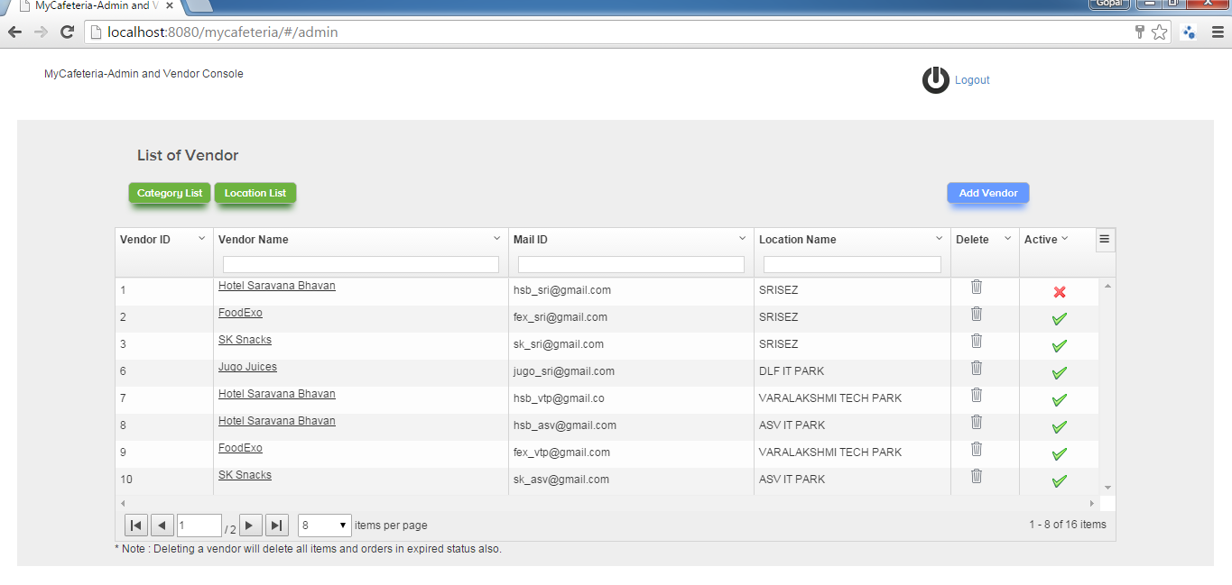
Screenshots for Admin Console - Vendors

Slide 22
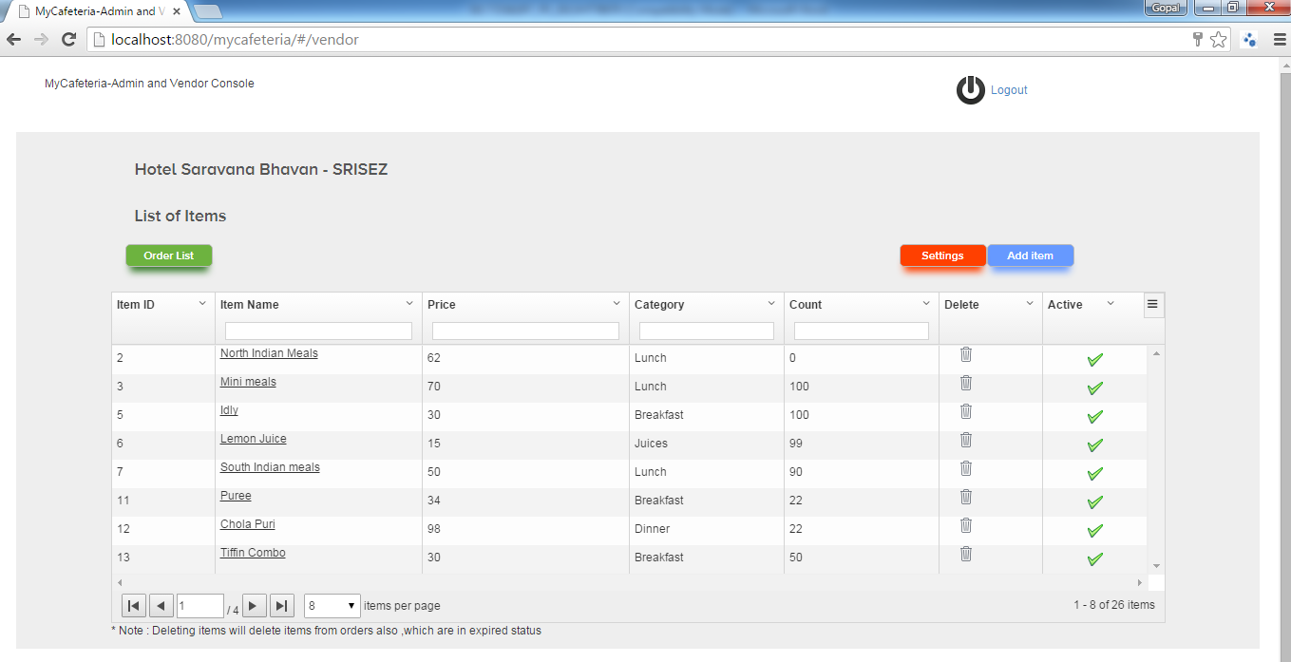
Screenshots for Vendor Console-Items

Slide 23
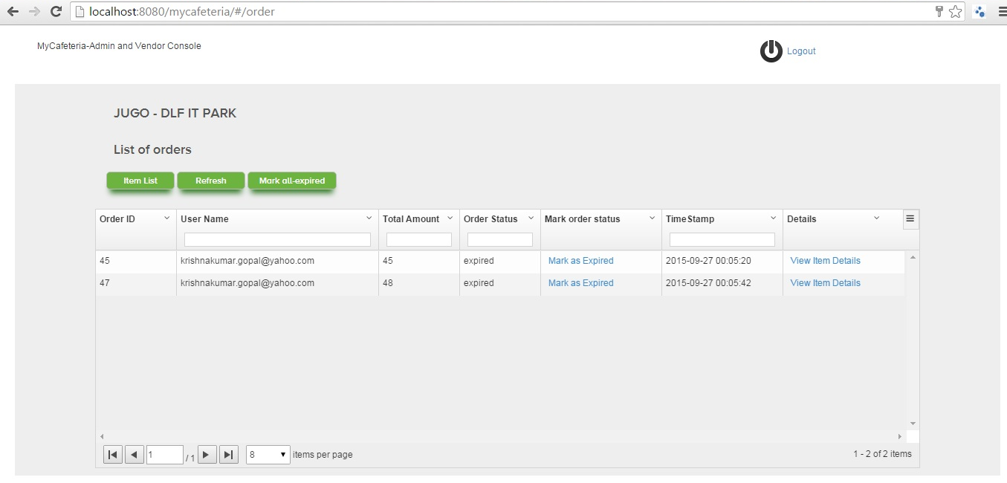
Screenshots for Vendor Console-Orders

Slide 24
Tools and Technologies used
Operating System - Windows XP/7, Android OS
Languages : Java , JavaScript
Framework : Android SDK, Java 1.7 JDK, Hibernate, JAX-RS
Database : MySQL
Web server: Apache Tomcat Server
Build Tool : Maven
Cloud : Amazon Cloud
UI Framework for web application: Angular js

